Slide 1
We Have Your Homebuyers’ Number — and It’s Less Than They Think!
Cobrand Logo Goes Here

Slide 2
Your Presenter
My name is <Insert Your Name> with <Your CU Organization Name> and I’ll be your presenter today.
<Insert Your CU Contact Info>
<Insert Your CU Company Logo>

Slide 3
Down Payments Can Be 10%, 7%, 3%, Even 1% or 0%
Renters can become homeowners faster than they ever expected with a mortgage structured using Arch MI’s Buy with MI solutions.
Many Prospective First-Time Buyers Think Down Payments Must Be 16% or More In a National Association of Realtors survey, 45% of respondents incorrectly said credit unions and other lenders require down payments of 16% or more.
In reality, first-time homebuyers average 8% down and with MI Home from Arch MI, eligible members can choose down payments as low as 3%, even 1% or 0%* — meaning many potential buyers already have sufficient savings.
More than two-thirds of prospective homebuyers think it will take more than three years to save enough for a down payment.
Source: Bankrate, January 2024
*Available for eligible members through Arch Mortgage Guaranty Company.

Slide 4
Current Renters
Chief Obstacle for Aspiring Homebuyers:
Not being able to afford the down payment is perceived as a top concern!
What Do Non-Owners Think Is the Biggest Hurdle in Buying a Home?
Down Payment | 45%
Income | 39%
Credit Score | 35%
Lack of Homes | 35%
Source: NerdWallet survey of non-owners who want to buy a home conducted in January 2024.

Slide 5
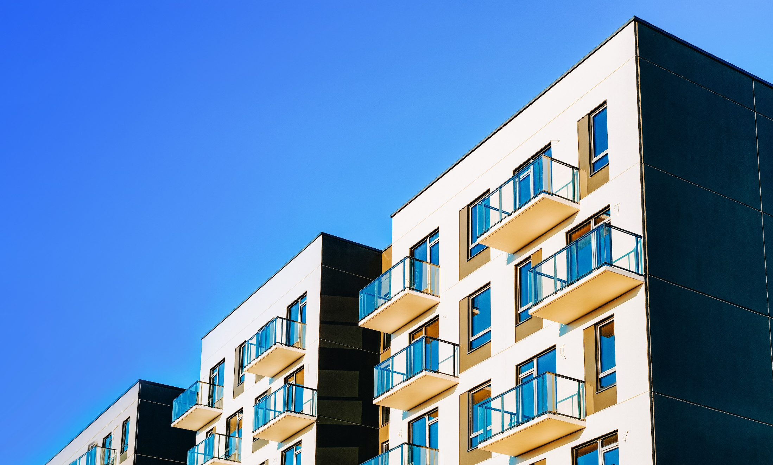
Fixed-Rate Mortgages Attractive as Rents Soar
Soaring Rents Nationally, the median monthly rent is $1,987, up 21.78% since 2020.
Source: Rent.com April 2024 Rent Report.

Slide 6
Millennial Homebuyers
Now the largest generation, Millennials are aging into their prime homebuying years and will be key drivers of housing demand over the remainder of the decade.
It would take a typical Millennial more than a decade to save enough for a 20% down payment on a median-priced home — the amount lenders require on loans not protected by mortgage insurance (MI).
The median annual salary for Millennials (ages 25‒34) is $54,912¹ and net worth (35 and younger), $39,000².
¹ Bureau of Labor Statistics, Q1, 2024.
² Federal Reserve Survey of Consumer Finances, October 2023.

Slide 7
Investing in Homeownership Builds Wealth
What Millennials coping with high rents should know:
Unlike rents — which are subject to periodic increases — a fixed-rate home loan is stable and predictable. The buyer’s principal and interest payments won’t rise over the life of the loan — up to 30 years.
Homeownership stands out as one of the best tools for building wealth:
The most recent Survey of Consumer Finances found the median net worth of homeowners is $396,200.
The median net worth of renters is $10,400.
Homes often appreciate in value over time. The median price of houses sold in the U.S. in 2024 is $420,000, up 32% since mid-2020, according to the Department of Housing and Urban Development (HUD).

Slide 8
Investing in Homeownership
Escaping high rents, achieving homeownership and building wealth over the long term are all possible for your Millennial clients once the down payment issue is solved.
Mortgage insurance (MI) is the answer.

Slide 9
MI Makes Low Down Payments Possible
If a homeowner defaults on an insured loan and the loan goes to foreclosure, the mortgage insurer covers a portion of the expenses and outstanding loan balance that the credit union cannot recover.
For homebuyers, a loan insured with MI means:
Lower down payments — as low as 5%, 3%, 1% or even 0% — allowed.
They can buy a home sooner.
They can buy more home for the same amount of cash at closing.
Home Purchase Price | 20% Down Payment (no MI) | 10% Down Payment (with MI) | 5% Down Payment (with MI) | 3% Down Payment (with MI) | 1% Down Payment (with MI)* | 0% Down Payment (with MI)*
$200,000 | $40,000 | $20,000 | $10,000 | $ 6,000 | $2,000 | $0
$300,000 | $60,000 | $30,000 | $15,000 | $ 9,000 | $3,000 | $0
$400,000 | $80,000 | $40,000 | $20,000 | $12,000 | $4,000 | $0
*Available for eligible members from Arch Mortgage Guaranty Company.

Slide 10
The Advantages of Conventional Loans with MI
Conventional insured (non-FHA) loans often have a lower monthly payment with more product options than FHA loans.
Advantages of Conventional Loans with Private MI
For Qualifying Buyers: Potential to save thousands in mortgage insurance premiums. Gifts/grants allowed to satisfy member’s minimum contribution.* Monthly and single MI options offer flexibility: Zero cash for premiums due at closing for monthly premiums or financed plans (including third-party financed options for singles). Cancelable and potentially refundable. Increased purchasing power and affordability. * When standard Agency gift/grant and Arch MI requirements are met. | For Realtors: Competitive edge: Client savings on monthly mortgage payment, repeat business and referrals from satisfied customers. Potential for faster and less complicated closings: No FHA appraisal/appraiser requirements. Easier for the seller to meet inspection requirements. Less paperwork can mean faster closing.

Slide 11
Private MI Can Be Canceled, Unlike FHA
Most FHA borrowers — those making down payments of less than 10% — continue paying FHA’s MI premium for the entire life of the loan.
For members with private MI, there are two ways for MI to be canceled:
Automatic Cancellation*
When the principal balance of the mortgage is first scheduled to reach 78% of the original value of the property.
The member must be current on mortgage payments.
Member-Initiated Cancellation*
When the principal balance of the mortgage reaches 80% LTV based on original value and scheduled amortization (or based on actual payments) and:
There are no subordinate liens.
The property has not declined in value.
The member is current on payments and has a good payment history (no payment more than 30 days late in the past year, or more than 60 days late in the past two years).
* Requirements vary by credit union/lender and may not be all-inclusive. members must contact their loan servicer for details on initiating cancellation before reaching 80% LTV, based on the original value of the property.

Slide 12
Arch MI’s Buy with MI
Comprising our full range of solutions, products and resources aimed at helping you structure and insure low down payment loans, Arch MI’s Buy with MI has everything credit unions need to attract, originate and close this valuable purchase business:
Manufactured homes, condos, co-ops, single-family and construction-to-perm all eligible.
Flexible Arch MI guidelines that work with down payments as low as 3%; gifts and grants allowed.
Down payments as low as 1% and 0% through Arch Mortgage Guaranty Company.
Competitive MI pricing and the option to create customized MI premium payments to fit member budgets.
Appraisal gaps? Use our MI strategy to eliminate the need for extra cash at closing.
Free homebuyer education for GSE loan programs via our website.*
Free Roadmap to Homeownership toolkit contains everything for your homebuyer seminars.
*Limited to members with loans insured by Arch MI or AMGC.

Slide 13
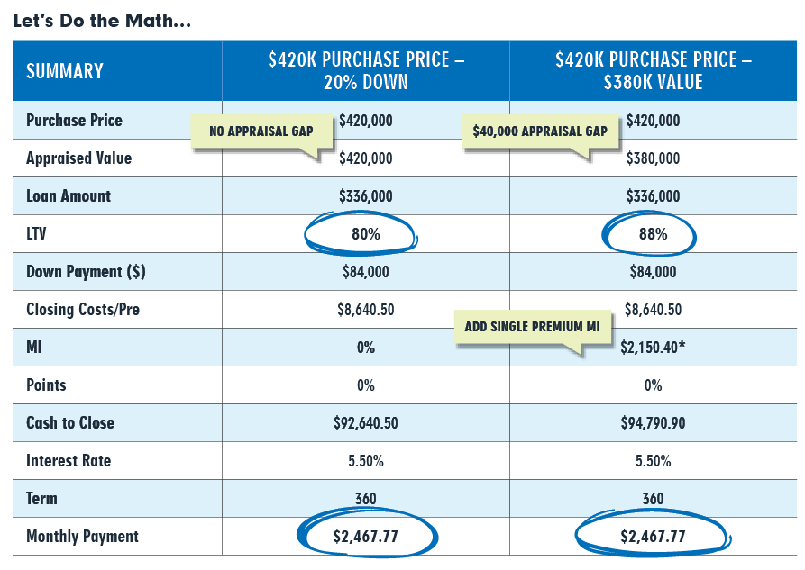
Arch MI’s Buy with MI: Eliminate Appraisal Gaps with MI
In the current housing market, low housing inventory means that purchase prices often exceed appraised values. Most loan originators, Realtors® and members believe that bridging the “appraisal gap” could cost thousands of dollars.
MI can make a real difference. Use Arch MI’s Buy with MI products to reduce — or even eliminate — any need for the member to come up with extra cash at closing.
*MI Pricing Assumptions: Two borrowers (760 credit scores), 20% housing ratio and 30% DTI purchasing a Tennessee (37221) single-family detached home — fixed-rate, 30-year mortgage with Community Banking Initiative pricing.

Slide 14
Arch MI’s Buy with MI: Complimentary GSE-Approved Homebuyer Education
Arch MI offers access to GSE-approved pre-purchase programs for members financing their home purchases with loans that include mortgage insurance:
Freddie Mac CreditSmart® course for Conventional Home Possible ® and HomeOne ® loan applications.
Fannie Mae HomeView ® course for Conventional and HomeReady ® loan applications.
Pathways to Homeownership course endorsed by HUD.
archmicu.com/hbe

Slide 15
Arch MI’s Buy with MI: Roadmap to Homeownership (RtHO)
The homebuying process can be confusing for many first-time buyers. In addition, they may have only a small down payment, substantial student debt or other circumstances that make them feel shut out of the market.
Credit unions can team up with local Realtors and use the RtHO toolkit to set up homebuyer seminars that explain the process, the benefits and the financial implications of homebuying.
The RtHO toolkit is complimentary and easily downloadable, and includes:
archmicu.com/rtho

Slide 16
Questions?
Find out if your customers qualify for a low down payment loan insured with MI.
Ask us about Arch MI’s Buy with MI.
archmicu.com/BuyWithMI

Slide 17
Contact Me
Contact Me
To discuss in more detail, please connect with me:
<Insert Your CU Contact Info Below>
First, Last Name
Title
Company
City, State ZIP Code
Phone Number
Email Address
Web Address

Slide 18
THANK YOU
Follow Us On:
LinkedIn (Arch Mortgage Insurance Company)
X (x.com/archmi_us)
Facebook.com (Facebook.com/Arch-Mortgage-Insurance)
Instagram (archmi_us)
Vimeo (archmi_us)
ARCH MORTGAGE INSURANCE COMPANY® | ARCH MORTGAGE GUARANTY COMPANY® | 230 NORTH ELM STREET GREENSBORO, NC 27401 | ARCHMICU.COM Arch MI is a marketing term for Arch Mortgage Insurance Company, Arch Mortgage Guaranty Company and United Guaranty Residential Insurance Company. Arch Mortgage Insurance Company and Arch Mortgage Guaranty Company are registered marks of Arch Capital Group (U.S.) Inc. or its affiliates. Realtor is a registered mark of the National Association of REALTORS. HomeReady and HomeView are registered marks of Fannie Mae. Home Possible, CreditSmart and HomeOne are registered marks of Freddie Mac. MCUS-B0094LCU-0724

